Slide 1
AirBnB’s in Los Angeles, CA
What affects price and availability in Los Angeles area AirBnB’s?

Slide 2
Hypothesis
To show that certain indirect factors go into affecting the price of an airbnb rental
Crime rate within the vicinity
Number of points of interest in the vicinity
Square footage of the property
To show that factors like superhost status and places of interest affect availability and pricing
Accomodations available
Superhost housing and reviews

Slide 3
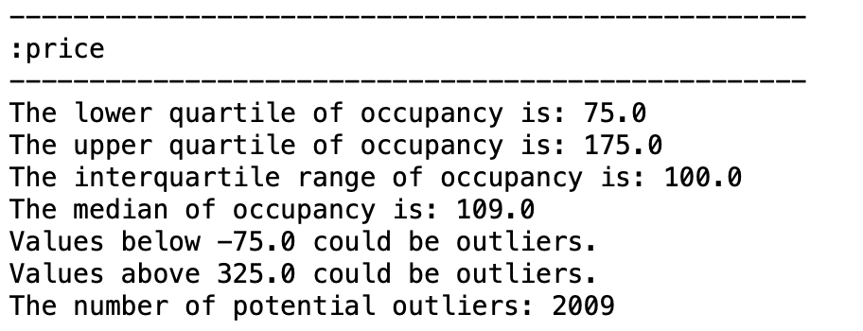
How did we determine our sample data?
Data from:
AirBnB data of Los Angeles: “http://insideairbnb.com/get-the-data.html”
Crime data of Los Angeles: “https://data.lacity.org/A-Safe-City/Crime-Data-from-2010-to-Present/63jg-8b9z”
Combine AirBnB and crime information (2019):
Calculate interquartile range of price:

Slide 4
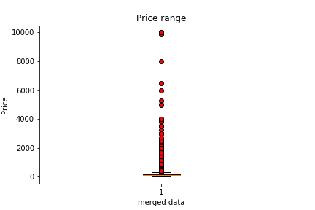
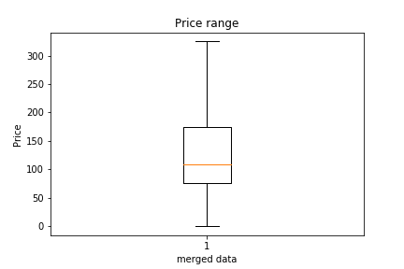
How did we determine our sample data?
Drop potential outliers:
Randomly select 1,000 samples from top 10 cities, add point of interest (google):
['Los Angeles', 'Long Beach', 'Santa Monica','West Hollywood','Pasadena', 'Glendale', ’Inglewood', 'Beverly Hills', 'Burbank', 'Alhambra']
Sample size ( https://www.surveymonkey.com/mp/sample-size-calculator/)

Slide 5
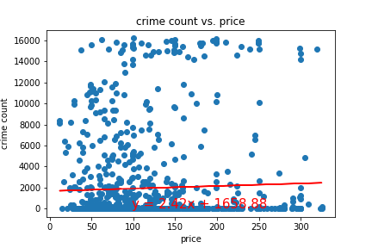
Price vs Crime
Do expensive AirBnB’s have low crime rate?
-> No significant correlation between price and crime
The r-squared is 0.03882833549308283

Slide 6
Price vs Crime
Reasons why we could not find a significant correlation between price and crime
-> Crime type (property/violent)
-> Tourism intense areas

Slide 7
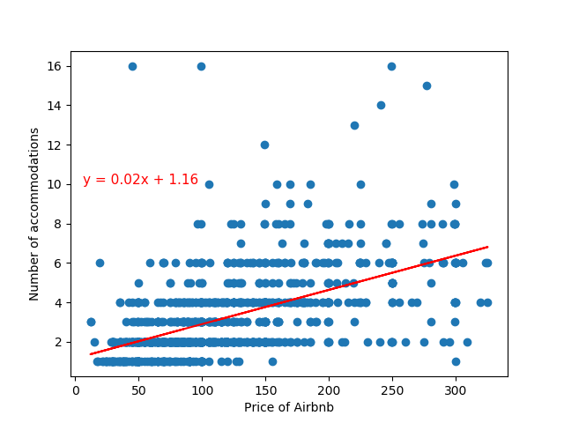
Price of Airbnb’s in correlation with number of accommodations
R-square: 0.55
Accommodations can vary from additional benefits such as:
Place is pet friendly
GYM
Parking
Coffee

Slide 8
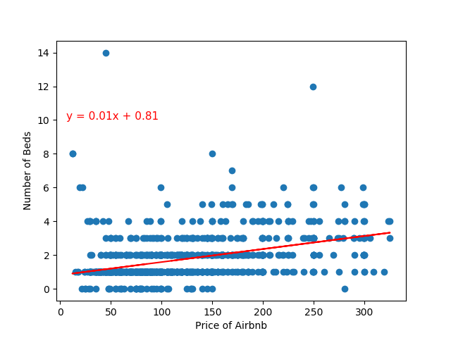
Price of Airbnb’s in correlation with number of beds available
R-square: 0.39
Other factors seem to play a much bigger role such as:
Location
Seasonality
Days of the week
Type of clients
Is the area touristy
Large events within the area

Slide 9
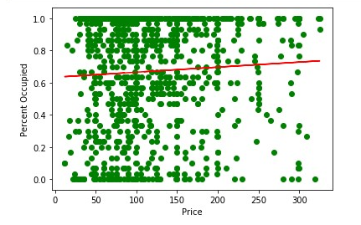
Price vs 30 Day Availability
Do more expensive AirBnb’s have less occupancy within 30 days?
Most Airbnbs are under 200.00 but little correlation between price and how many properties are available within 30 days.

Slide 10
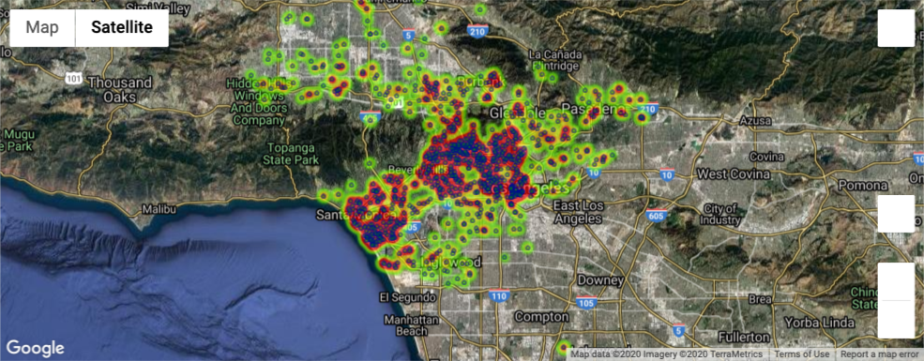
Price Heat Map With Points of Interest

Slide 11
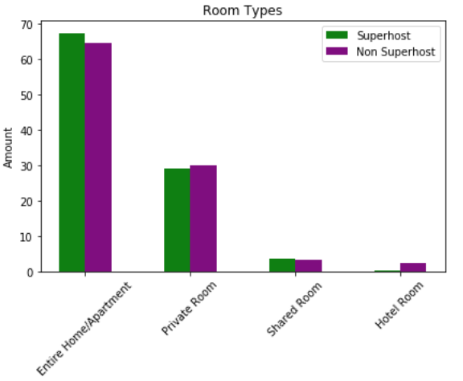
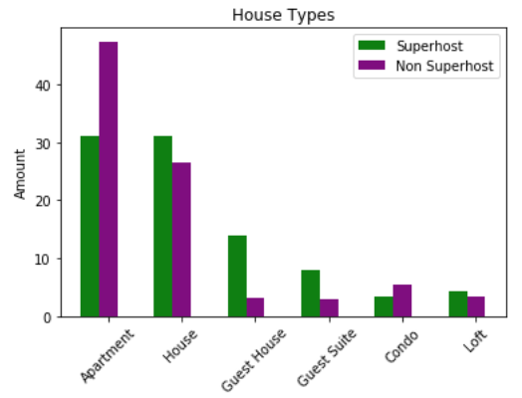
Housing Types between Superhosts and Non Superhosts
Initial thoughts: Higher prices leading to more variety among Superhost accommodations

Slide 12
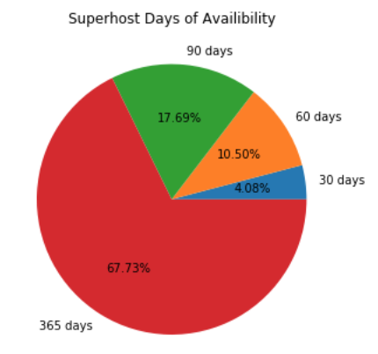
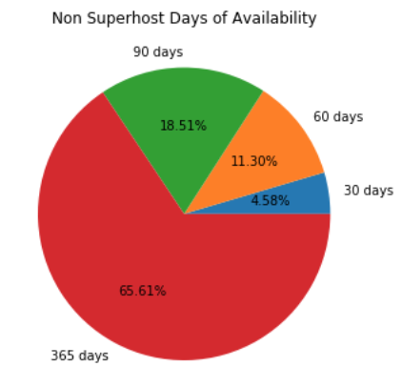
Days of Availability
Initial thoughts: More days of availability with Superhost accommodations
30 days, 60 days, 90 days, 365 days
Results: Identical
Superhost
Non Superhost

Slide 13
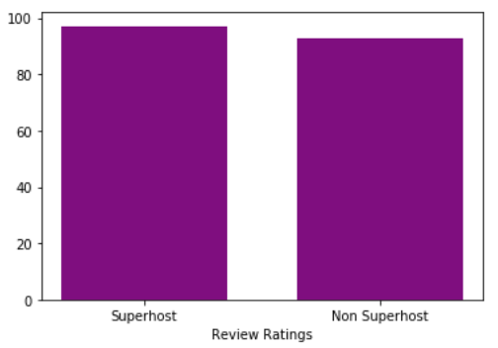
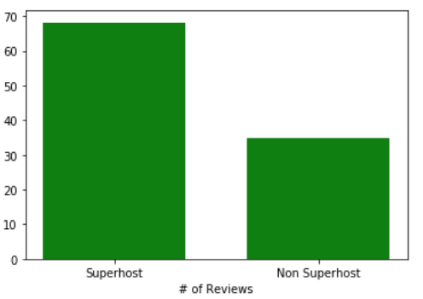
Reviews and Ratings
Review Ratings
Number of Reviews
Identical review ratings, significant margin in # of reviews

Slide 14
Superhost and Non Superhost versus Pricing
Identical numbers in Room Types, Days of Availability, and Review Ratings
Difference: Superhost owners had more diverse accommodations
Difference: Superhost accomodations had 2x the amount of reviews
Pricing was identical among all Superhost vs Non Superhost listings
Pricing
Superhost: $119.24
Non Superhost: $117.77

Slide 15
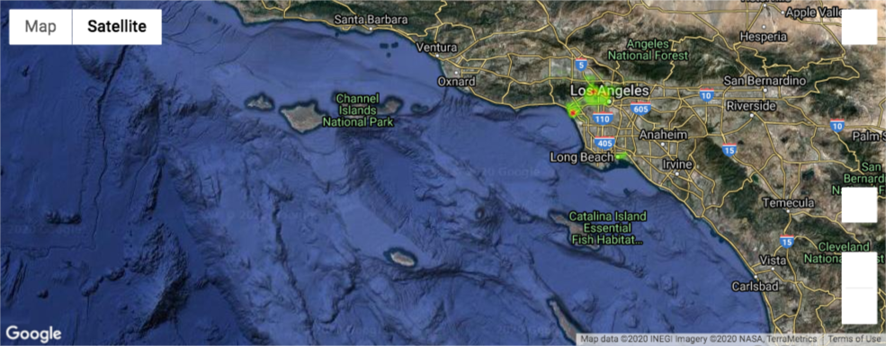
Zip Code Heat Map Superhost Airbnb
90046: West Hollywood, Hollywood, Hollywood Hills, Bel Air/Beverly Crest, Cahuenga Pass
90291: Venice , Marina Del Rey

Slide 16
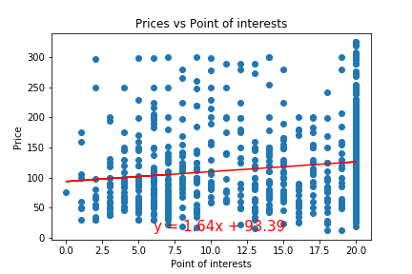
Price vs Point of interests
Do more expensive AirBnb’s are closer to the attractions?
Not a strong correlation between price and point of interests
The r-squared is: 0.15245219487906508

Slide 17
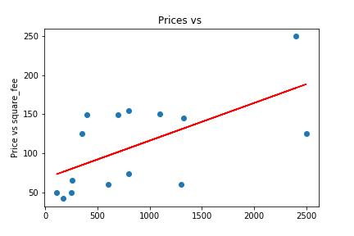
Price vs square feet
Do more expensive AirBnb’s have larger square feet?
There might be a correlation between price and size but we didn’t have sufficient data to prove that.
The r-squared is: 0.6178283400221946

Slide 18
Conclusion
Most studies showed there was little to no correlation to the factors we studied like crime, accomodations, and availability.
Superhost status did not affect how busy a property is.
Possible correlation between price and square footage exists but factors such as:
Location
Seasonality
Type of clients
Large events within the area
Play a larger role.
Ideas for further analysis:
The next step in analysis would be to see real estate market values to see if we could find a solid correlation with a more direct factor, however, we wanted to explore factors that may come off as more indirect.

